Slide 1
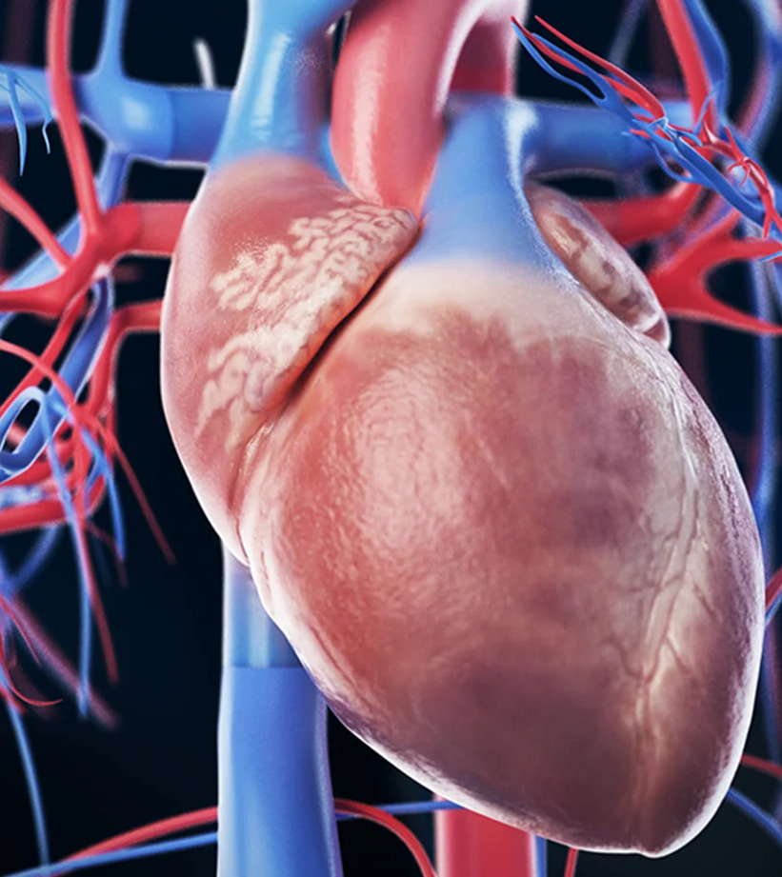

Stroke Prediction
Kiel Rotz
Springboard Data Science Capstone
August 11th, 2021

Slide 2
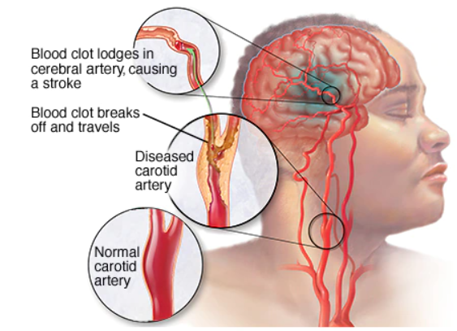
What is a stroke?
Interruption in normal blood flow to the brain leading to cell death
Ischemic stroke:
Blood clot lodged in blood vessel deprives brain of O2 and nutrients
Hemorrhagic stroke:
Bleeding in the brain from ruptured blood vessel

Slide 3
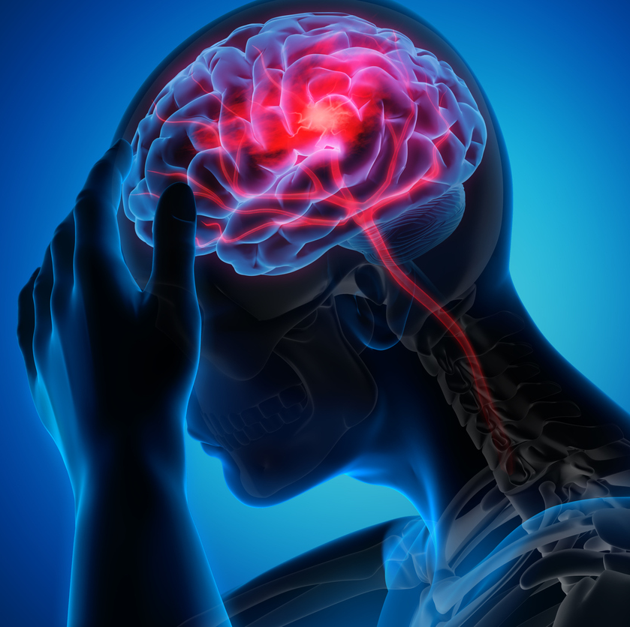
The Problem
Stroke kills ~ 150,000 Americans each year
No.5 leading cause of death in US
The past decade has seen a 44% increase in strokes for young Americans

Slide 4
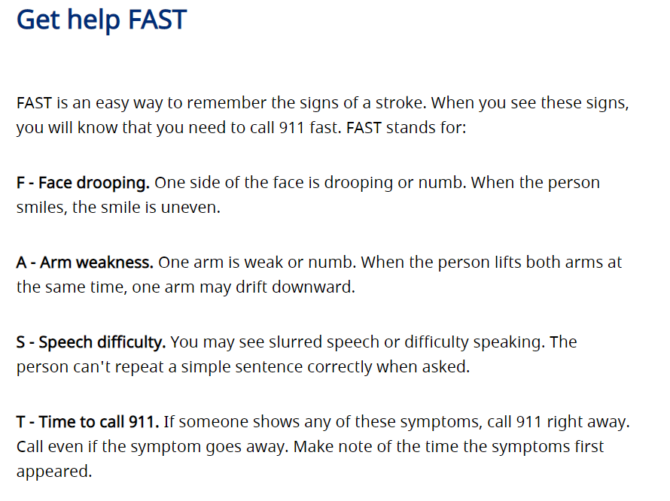
What are the known risk factors for stroke?
Health indicators
Hypertension, cardiovascular disease, diabetes, hyperlipidemia, obesity, abnormal heart rhythm, structural cardiac abnormalities, Hx of stroke
Sociodemographic
age, sex, ethnicity, low SES,
Behavioral
Smoking, drinking, lack of exercise

Slide 5

Our Goal
In the era of big data, doctors and scientists are constantly trying to find ways to predict those who are at risk of disease.
Using machine learning algorithms, we want to build a model that can predict stroke using various health and sociodemographic attributes

Slide 6
The Data Stroke Prediction Dataset from Kaggle website
Health features
Sociodemographic features
Hypertension
Heart disease
Average glucose level
BMI
Stroke (target variable)
Gender
Age
Ever married
Work type (private, govt, etc.)
Residence type (urban/rural)
Smoking status

Slide 7
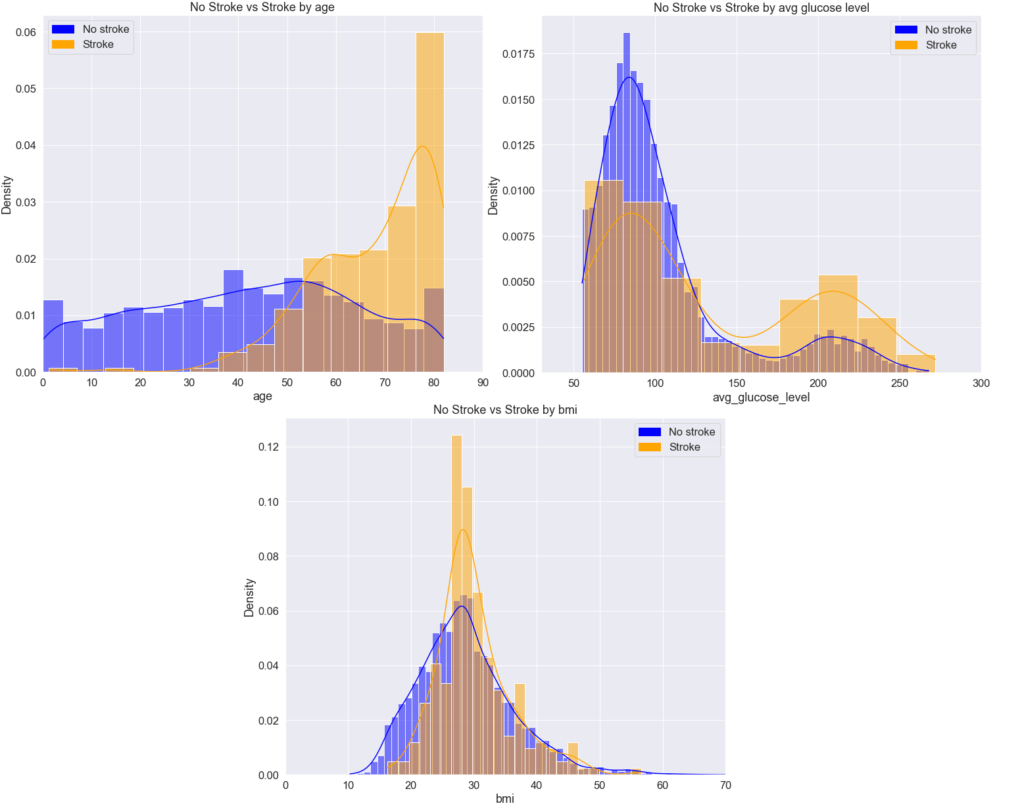
Data Exploration
Here we can see the differences in the distributions between stroke and non-stroke
The clearest distinction is with age

Slide 8
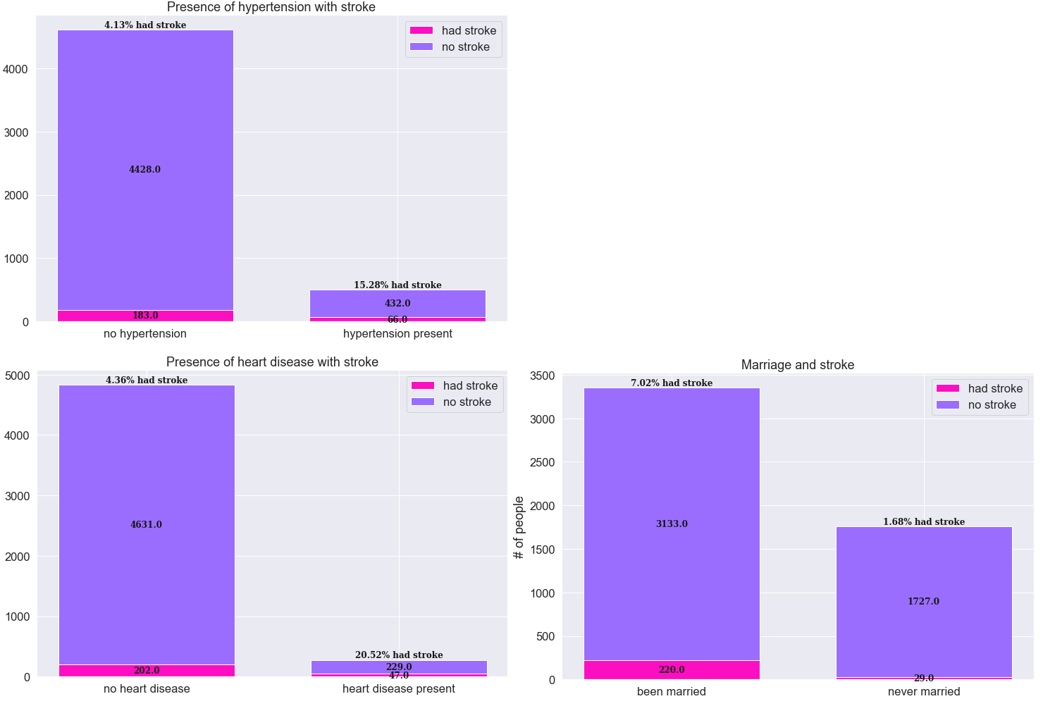
Data Exploration
These features seem to be from different distributions
Those with hypertension and/or heart disease had a higher stroke rate in our dataset
Those who have been married had a higher stroke rate than never married
Consider where collinearity might be occurring

Slide 9
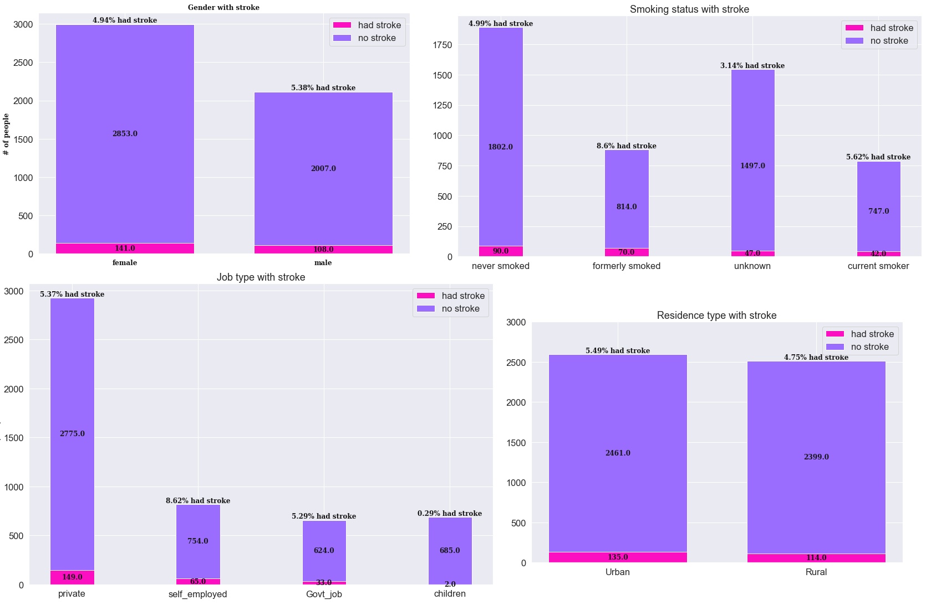
Data Exploration
These feature distributions are not clearly different
In our dataset males had a slightly higher rate of stroke
Former smokers had a higher rate of stroke than current smokers
Self-employed people had a higher stroke rate than other job types
Urban residents had a slightly higher stroke rate than rural ones.

Slide 10
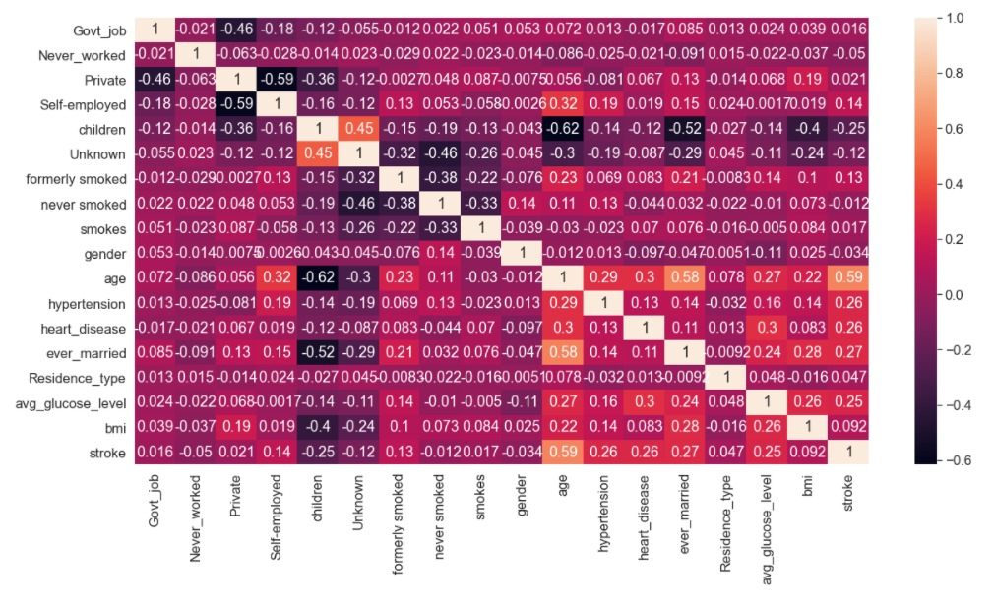
Data Exploration
Correlation Heatmap
Look at the highly correlated features
What is surprising here?

Slide 11
Machine Learning Modeling
https://github.com/rotznmu/stroke_prediction_capstone

Slide 12
Modeling Overview
Type: Supervised learning
Binary classification: 1 for stroke and 0 for non-stroke
Highly imbalanced data: ~5% is class 1
Needs special attention
Tools: Python’s scikit learn

Slide 13
Modeling Steps
Data Pre-processing steps:
Data Cleaning and imputation
Encoding
Splitting the data into train and test sets (75%/25%)
Scaling
Feature Selection
Cross validation (CV) for hyperparameter tuning:
5 fold CV
Used a custom function that oversamples on training folds only
Evaluation Metrics: Recall & Average Precision
Classifier training using optimal parameters and 75% of whole data
Performance evaluation using holdout dataset (25% of the whole data)

Slide 14
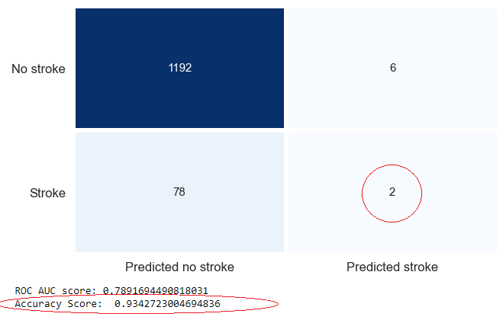
Evaluation Metrics
Why Recall and Average Precision?
Our dataset has highly imbalanced classes
Using more typical parameters like accuracy would give a deceptive estimate of what we are trying to accomplish
Recall tells us our ability to find the true positives (i.e. those with stroke)
Average Precision shows the trade-off between precision and recall across different thresholds

Slide 15
Classification Algorithms Used:
XGBoost
Bernouilli Naïve Bayes
Gaussian Naïve Bayes
Logistic Regression
Decision Tree
Random Forest
SVC
K-Nearest Neighbors
LGBM Classifier

Slide 16
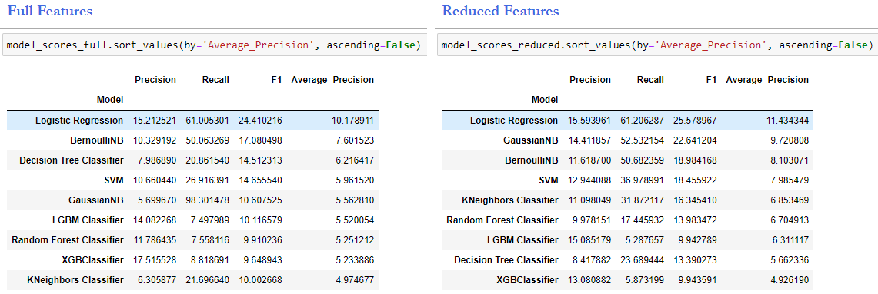
Summary Table w/out hyperparameter tuning

Slide 17
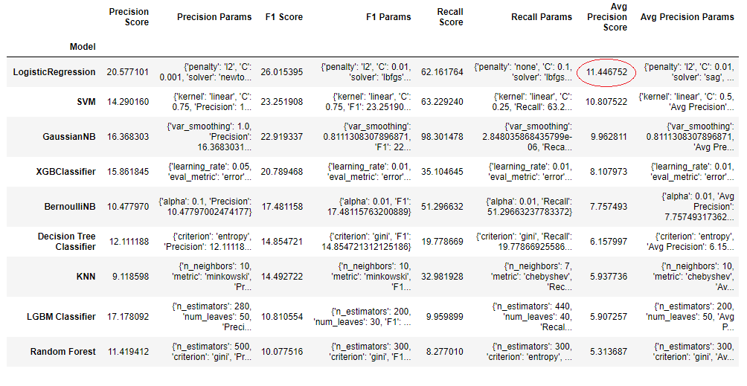
Summary Table with hyperparameter tuning

Slide 18
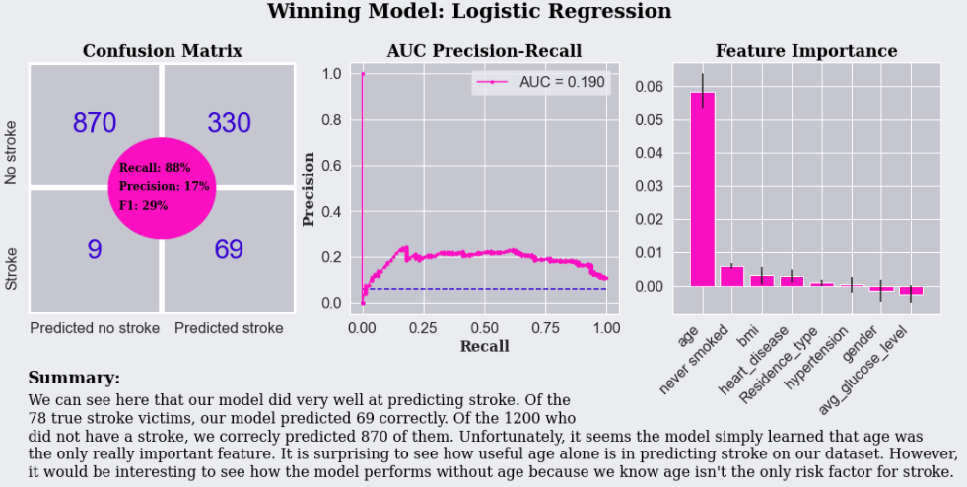
Some Details on the Best Model

Slide 19
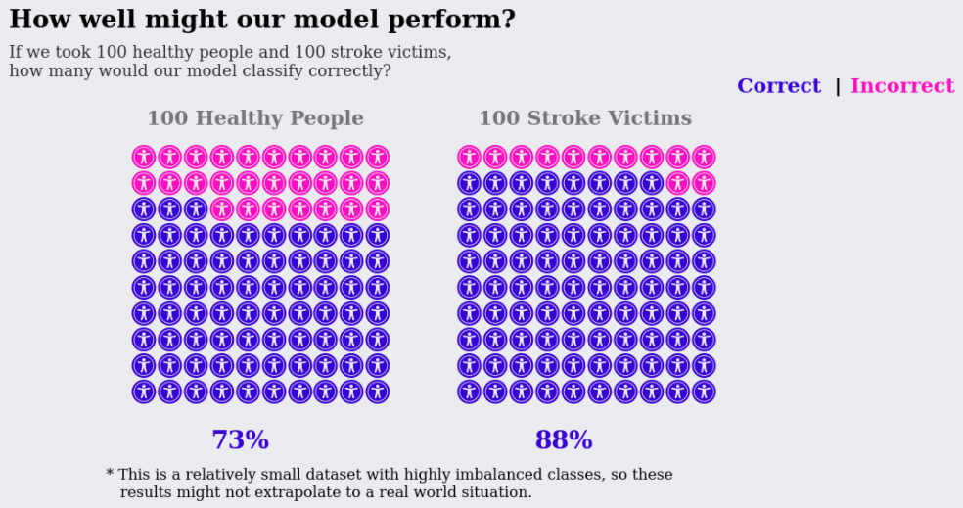
Prediction Ability

Slide 20

Ideas for Future Models
More data
Limited data left us unable to have a validation set and overfitting problems on oversampled data
More health features
This had the strongest influence on our model
More Sociodemographic features
Perhaps not a large enough dataset to find a signal on sociodemographic features
Perhaps situational features
E.g. environmental toxins like presence of high lead levels in water.

Slide 21
Thank you!

